Slide 1
Consistency of Replicated Database Part II
CS-212 Distributed Database Systems
Instructor: Ms. Mariam Nosheen
Computer Science Department LCWU, Lhr

Slide 2
Forms of Replication
Ms. Mariam Nosheen
CS- 212 Distributed Database Systems

Slide 3
Outline
Data Replication
➡ Replication protocols
➡ Replication and failure management
Ms. Mariam Nosheen
CS- 212 Distributed Database Systems

Slide 4
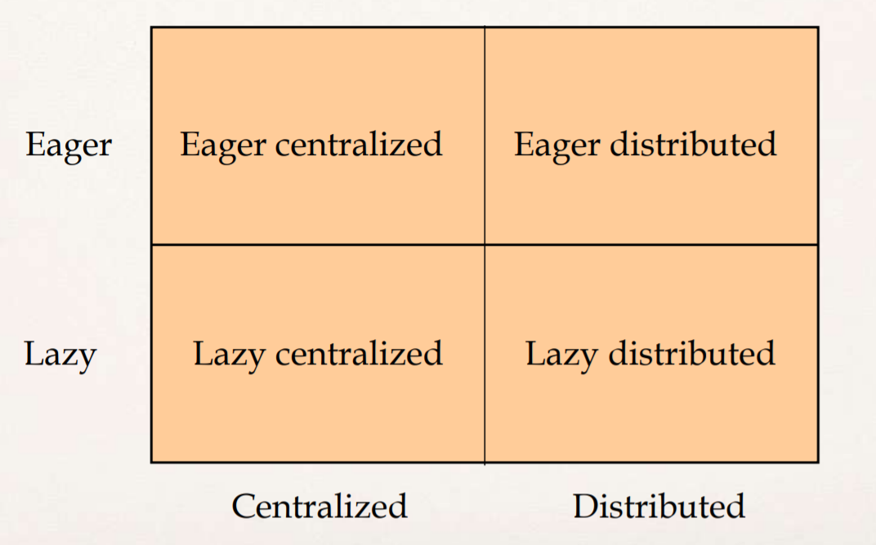
Replication Protocols
The previous ideas can be combined into 4 different replication protocols:
1
2
3
4
Ms. Mariam Nosheen
CS- 212 Distributed Database Systems

Slide 5
(1) Eager Centralized Protocols
Design parameters:
➡ Distribution of master
✦ Single master: one master for all data items
✦ Primary copy: different masters for different (sets of) data items
➡ Level of transparency
✦ Limited: applications and users need to know who the master is
✓ Update transactions are submitted directly to the master
✓ Reads can occur on slaves
✦ Full: applications and users can submit anywhere and the operations will be forwarded to the master
✓ Operation-based forwarding
Four alternative implementation architectures, only three are meaningful:
➡ Single master, limited transparency
➡ Single master, full transparency
➡ Primary copy, full transparency
Ms. Mariam Nosheen
CS- 212 Distributed Database Systems

Slide 6
(1) Eager Centralized Replication
Eager Single Master/Limited Transparency
Eager Single Master/Full Transparency
Eager Primary Copy/Full Transparency
Ms. Mariam Nosheen
CS- 212 Distributed Database Systems

Slide 7
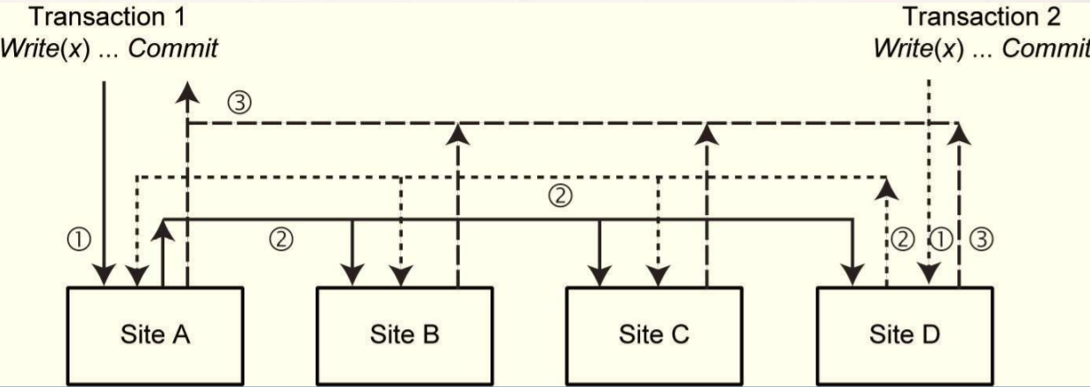
(2)Eager Distributed Protocol
Updates originate at any copy
➡ Each sites uses 2 phase locking.
➡ Read operations are performed locally.
➡ Write operations are performed at all sites (using a distributed locking protocol).
➡ Coordinate 2PC
Slaves:
➡ As before
Ms. Mariam Nosheen
CS- 212 Distributed Database Systems

Slide 8
(2) Eager Distributed Protocol (cont’d)
Critical issue:
➡ Concurrent Writes initiated at different master sites are executed in the same order at each slave site
➡ Local histories are serializable (this is easy)
Advantages
➡ Simple and easy to implement
Disadvantage
➡ Very high communication overhead
✦ n replicas; m update operations in each transaction: n*m messages (assume no multicasting)
✦ For throughput of k tps: k* n*m messages
Alternative
➡ Use group communication + deferred update to slaves to reduce messages
Ms. Mariam Nosheen
CS- 212 Distributed Database Systems

Slide 9
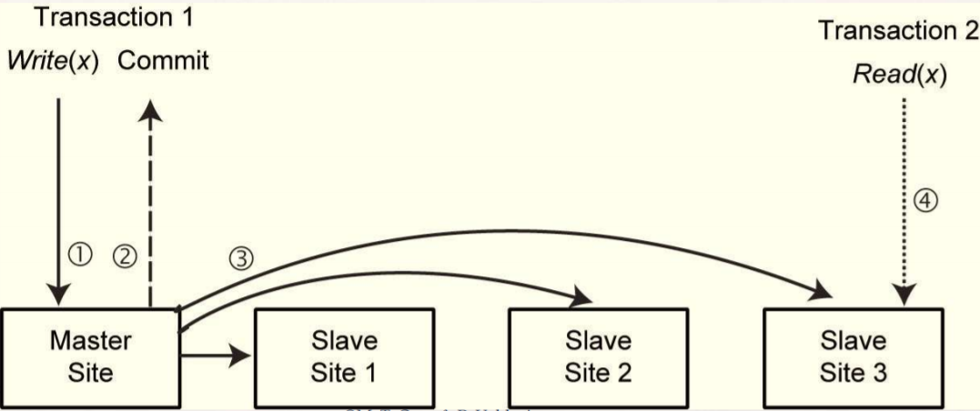
(3) Lazy Centralized Replication Protocol
Lazy Single Master/Limited Transparency
Update transactions submitted to master
Master:
➡ Upon read: read locally and return to user
➡ Upon write: write locally and return to user
➡ Upon commit/abort: terminate locally
➡ Sometime after commit: multicast updates to slaves (in order)
Slaves:
➡ Upon read: read locally
➡ Refresh transactions: install updates
Ms. Mariam Nosheen
CS- 212 Distributed Database Systems

Slide 10
(3) Lazy Centralized Replication Protocol
Lazy Primary Copy/Limited Transparency
Lazy Primary Copy/Limited Transparency – Slaves
Lazy Single Master/Full Transparency
Ms. Mariam Nosheen
CS- 212 Distributed Database Systems

Slide 11
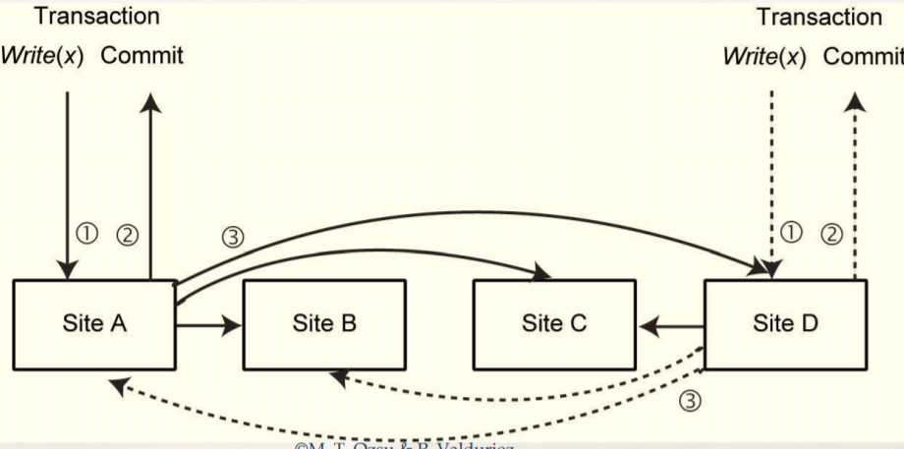
(4) Lazy Distributed Replication Protocol
Any site:
➡ Upon read: read locally and return to user
➡ Upon write: write locally and return to user
➡ Upon commit/abort: terminate locally
➡ Sometime after commit: send refresh transaction
➡ Upon message from other site
✦ Detect conflicts
✦ Install changes
✦ Reconciliation may be necessary
Ms. Mariam Nosheen
CS- 212 Distributed Database Systems

Slide 12
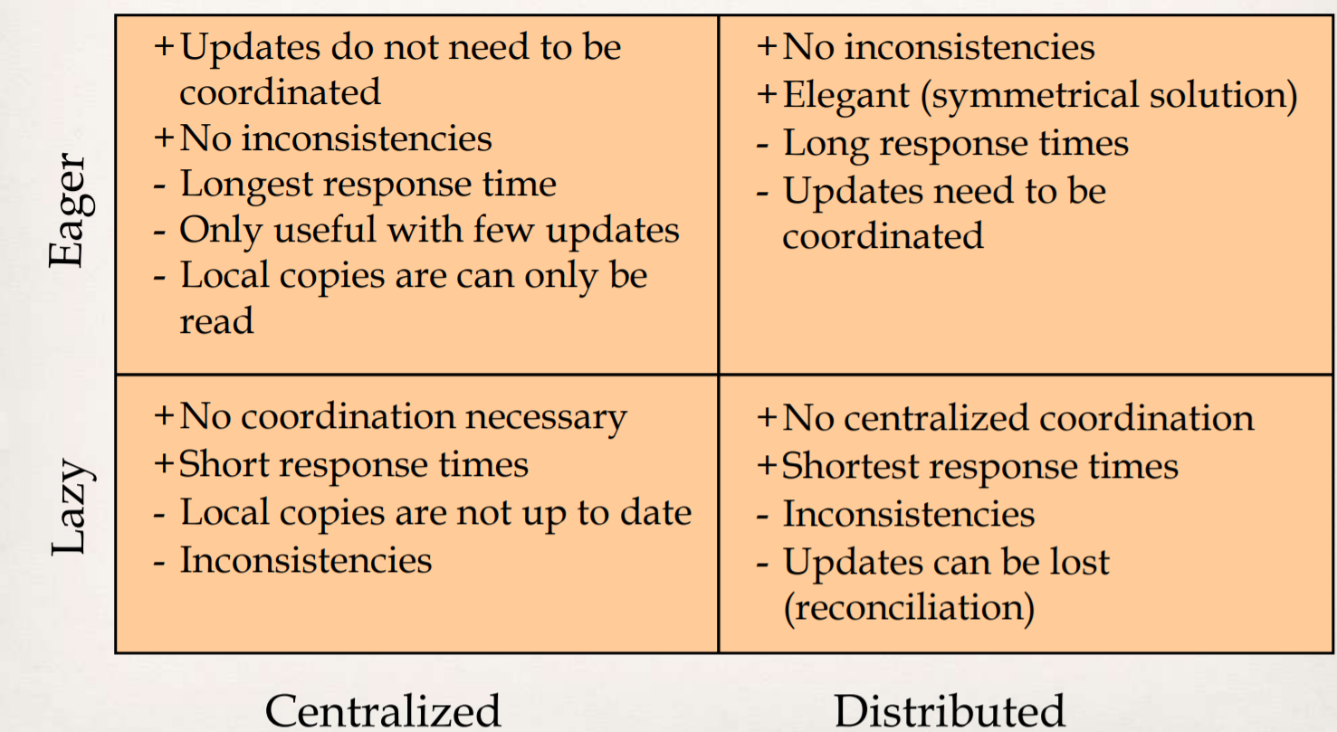
Replication Strategies (Summary)
Ms. Mariam Nosheen
CS- 212 Distributed Database Systems

Slide 13
Group Communication
A node can multicast a message to all nodes of a group with a delivery guarantee
Multicast primitives
➡ There are a number of them
➡ Total ordered multicast: all messages sent by different nodes are delivered in the same total order at all the nodes
Used with deferred writes, can reduce communication overhead
➡ Remember eager distributed requires k*m messages (with multicast) for throughput of ktps when there are n replicas and m update operations in each transaction
➡ With group communication and deferred writes: 2k messages
Ms. Mariam Nosheen
CS- 212 Distributed Database Systems

Slide 14
Failures
So far we have considered replication protocols in the absence of failures
How to keep replica consistency when failures occur
➡ Site failures
✦ Read One Write All Available (ROWAA)
➡ Communication failures
✦ Quorums
➡ Network partitioning
✦ Quorums
A quorum is the minimum number of votes that a distributed transaction has to obtain in order to be allowed to perform an operation in a distributed system.
The fundamental idea is that a transaction is executed if the majority of sites vote to execute it.
Ms. Mariam Nosheen
CS- 212 Distributed Database Systems

Slide 15
ROWAA with Primary Site
READ = read any copy, if time-out, read another copy.
WRITE = send W(x) to all copies. If one site rejects the operation, then abort. Otherwise, all sites not responding are “missing writes”.
VALIDATION = To commit a transaction
➡ Check that all sites in “missing writes” are still down. If not, t hen abort the transaction.
✦ There might be a site recovering concurrent with transaction updates and these may be lost
➡ Check that all sites that were available are still available. If some do not respond, then abort.
Ms. Mariam Nosheen
CS- 212 Distributed Database Systems

Slide 16
Distributed ROWAA
Each site has a copy of V
➡ V represents the set of sites a site believes is available
➡ V(A) is the “view” a site has of the system configuration.
The view of a transaction T [V(T)] is the view of its coordinating site, when the transaction starts.
➡ Read any copy within V; update all copies in V
➡ If at the end of the transaction the view has changed, the transaction is aborted • All sites must have the same view!
To modify V, run a special atomic transaction at all sites.
➡ Take care that there are no concurrent views!
➡ Similar to commit protocol.
➡ Idea: Vs have version numbers; only accept new view if its version number is higher than your current one
Recovery: get missed updates from any active node
➡ Problem: no unique sequence of transactions
Ms. Mariam Nosheen
CS- 212 Distributed Database Systems

Slide 17
Conclusion
Ms. Mariam Nosheen
CS- 212 Distributed Database Systems

